Slide 1




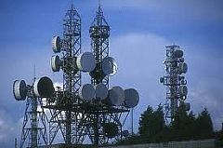
ELNG 307 – ANALOG AND DIGITAL COMMUNICATIONS

Slide 2
University of Energy and Natural Resources, Sunyani
Dept. of Computer & Electrical Eng.
ELNG 307 – ANALOG AND DIGITAL COMMUNICATIONS
Tweneboah-Koduah S.

Slide 3
CHAPTER 2 – Introduction to Signals and Spectra Analysis
Quote: Some books are to be tasted, others to be swallowed, and some few to be chewed and digested
– Francis Bacon

Slide 4
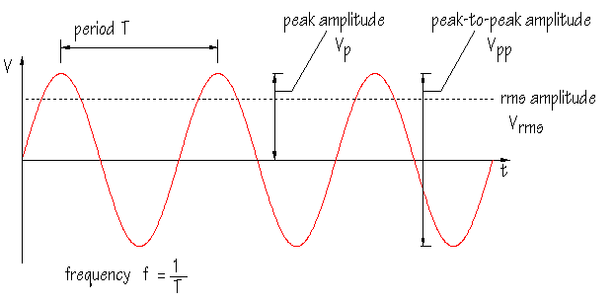
Signals
Consider a sine wave of amplitude V
  The frequency of the curve is cycles per second measured in Hertz (Hz)
  Amplitude is distance above a reference line
  A cycle is one complete wave
  Frequency spectrum defines the bandwidth for different analog communication
Analog signals should be digitized for computer processing
  The digitized signal is presented in binary form
Continuous – time signals
Discrete – time signal

Slide 5
Classifications of signals
Signals in engineering systems are typically described with the mathematical classifications
  Continuous Time or Discrete Time (and Analog or Digital)
  Periodic or Aperiodic
  Deterministic or Random
  Energy or Power

Slide 6
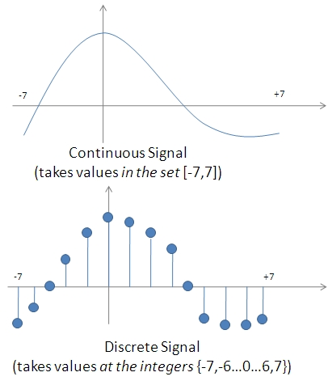
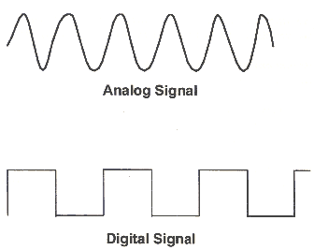
Continuous / Discrete time signal

Slide 7
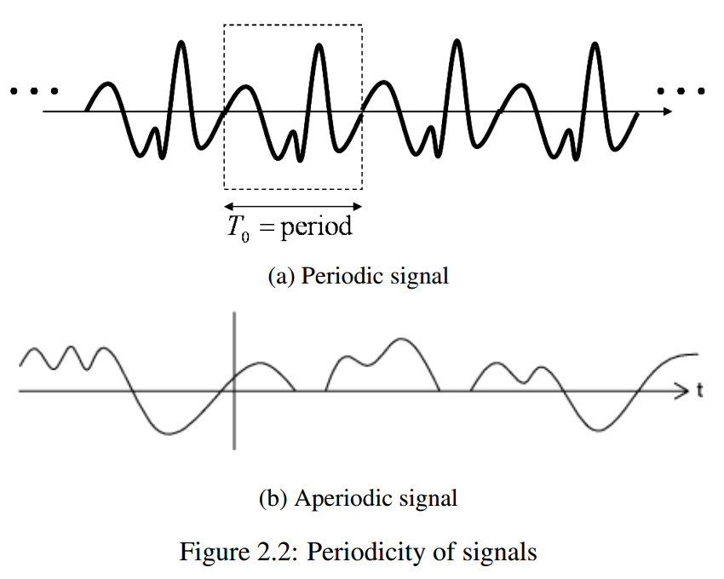
Periodic / Aperiodic signal
Notes:
Periodic function is expressed as $f\left(t\right)=f\left(f+T\right), −∞<t<+∞$
A signal that repeats its pattern over a period is called periodic signal
A signal that does not repeats its pattern over a period is called aperiodic signal or non periodic

Slide 8
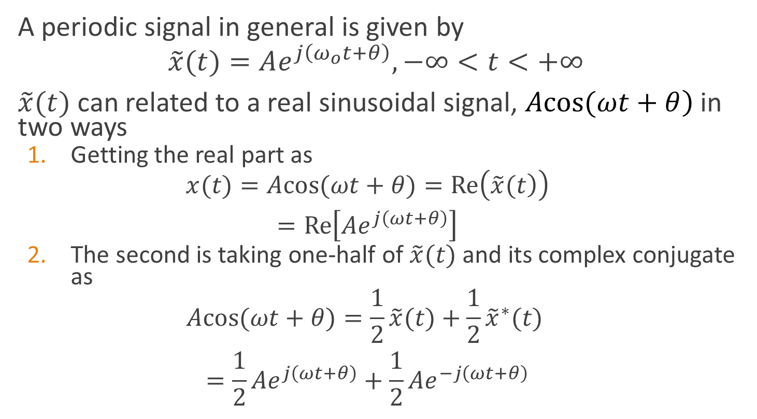
Phasor signal and spectra
A periodic signal in general is given by
$$\tilde{x}(t)=Ae^{j\left(ω_{o}t+θ\right)},−∞<t<+∞$$
$\tilde{x}(t)$ can related to a real sinusoidal signal, $\left.Acos(ωt+θ\right)$ in two ways
  Getting the real part as
  $$\begin{matrix}x(t)=Acos(ωt+θ)=Re\left(\left.\tilde{x}(t\right)\right) \\ =Re\left[Ae^{j\left(ωt+θ\right)}\right]\end{matrix}$$
  The second is taking one-half of $\tilde{x}(t)$ and its complex conjugate as
  $$\begin{matrix}Acos(ωt+θ)=\frac{1}{2}\tilde{x}(t)+\frac{1}{2}{\tilde{x}}^{∗}(t) \\ =\frac{1}{2}Ae^{j\left(ωt+θ\right)}+\frac{1}{2}Ae^{−j\left(ωt+θ\right)}\end{matrix}$$
Notes:
Where A is amplitude, phase $θ$ in radians and frequency $ω_{o}$.

Slide 9
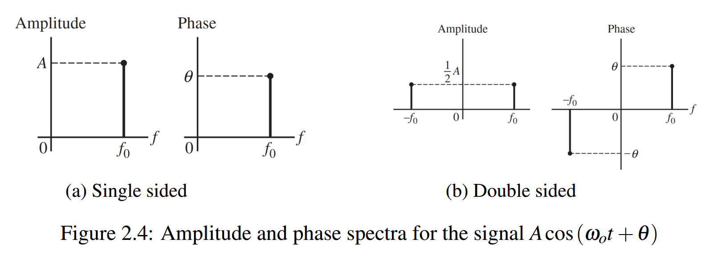
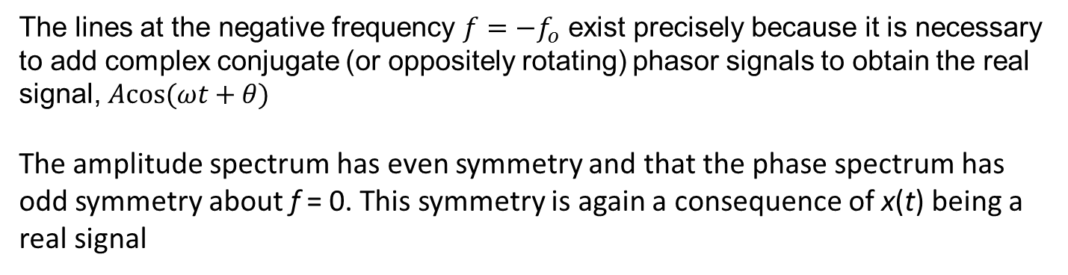
Phasor signal and spectra
The lines at the negative frequency $f=−f_{o}$ exist precisely because it is necessary to add complex conjugate (or oppositely rotating) phasor signals to obtain the real signal, $Acos(ωt+θ)$
The amplitude spectrum has even symmetry and that the phase spectrum has odd symmetry about f = 0. This symmetry is again a consequence of x(t) being a real signal
Notes:
$$f=−f_{o}$$

Slide 10
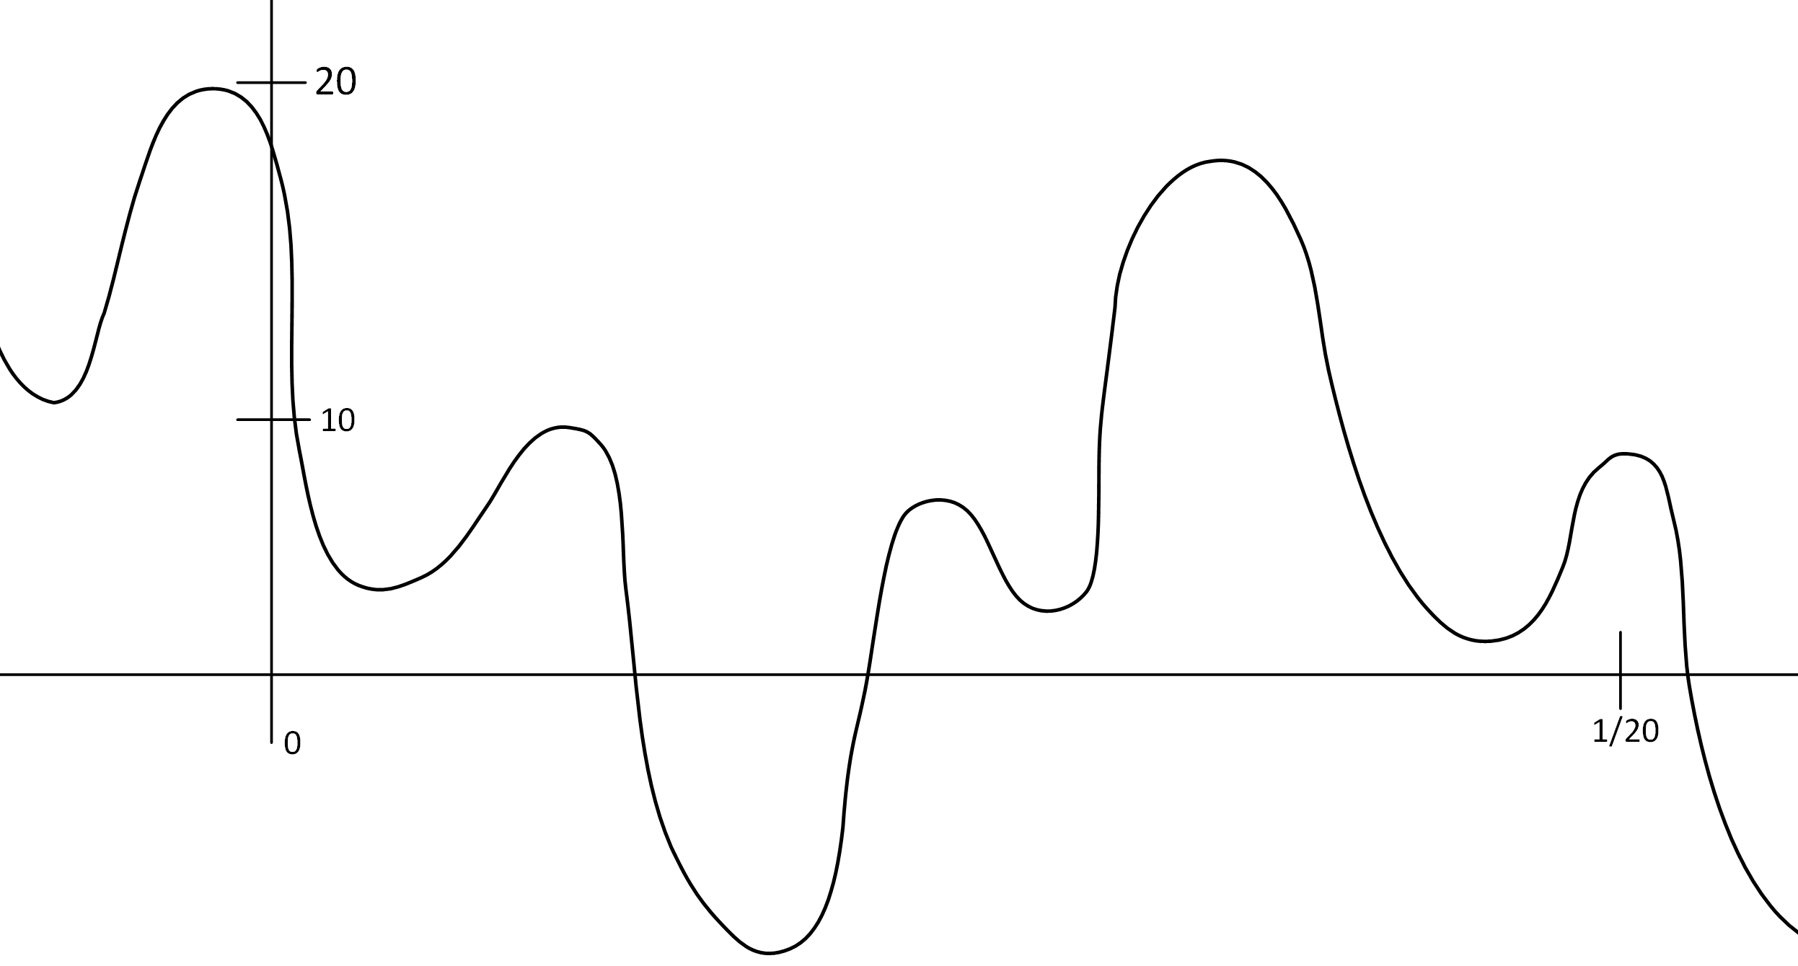

Phasor signal and spectra
Example 2.1
Find the phase and spectrum representation of the signal in Figure 2.5
$w(t)=7−10cos\left(40πt−{60}^{o}\right)+4sin120πt$
Figure 2.5: Complex waveform
Notes:
$$w(t)=7−10cos\left(40πt−{60}^{o}\right)+4sin120πt$$

Slide 11
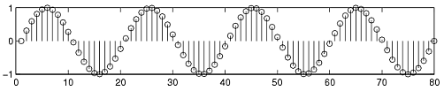
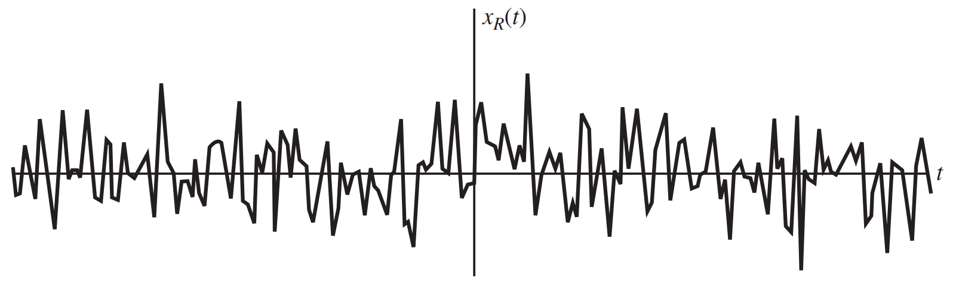
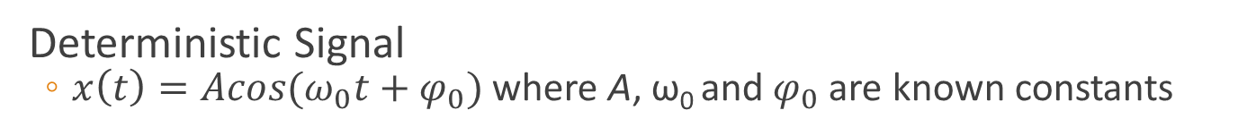
Deterministic / Random signal
Deterministic Signal
  $x\left(t\right)=Acos(ω_{0}t+φ_{0})$ where A, ω₀ and $φ_{0}$ are known constants
Random signal

Slide 12
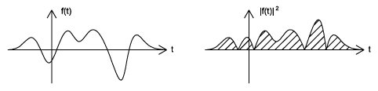
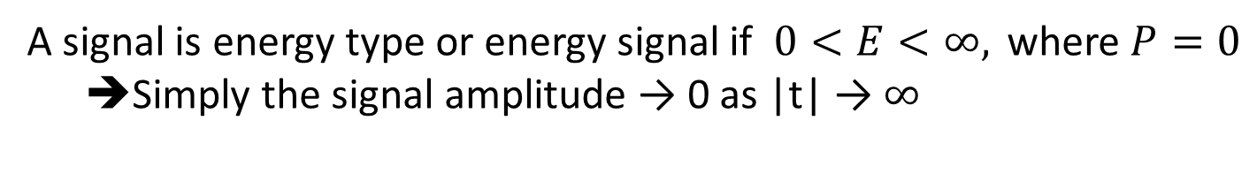
Energy / Power signal
The size of any entity is a number that indicates the largeness or strength of that entity
  A signal is energy type or energy signal if $0<E<∞, \text{where} P=0$
  ➔Simply the signal amplitude → 0 as |t| → $∞$

Slide 13
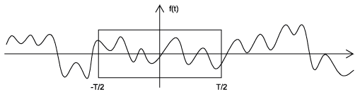
Energy / Power signal
The size of any entity is a number that indicates the largeness or strength of that entity
  f(t) is power type or power signal if and only if $0<P<∞$ ➔ The energy is infinite $E=∞$

Slide 14

Energy / Power signal
Example 2.2
Computer the average power of the signal below
$$x_{p}(t)=Acos\left(ω_{o}t+θ\right)$$

Slide 15
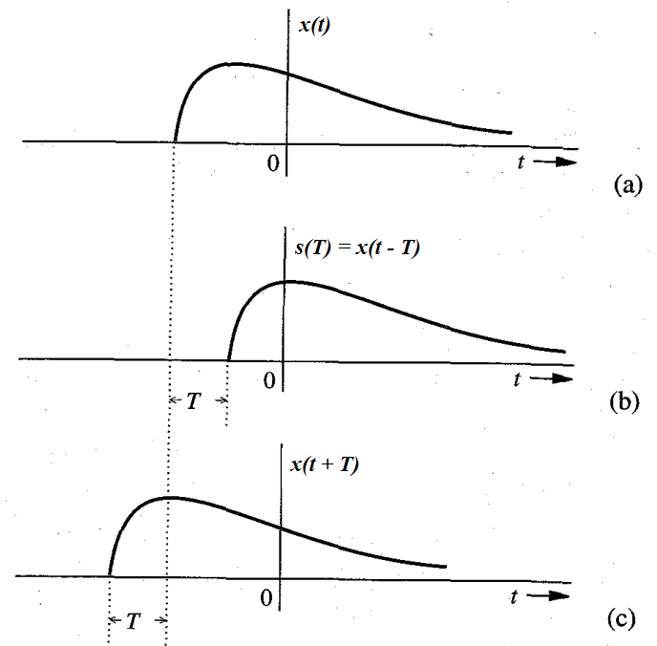
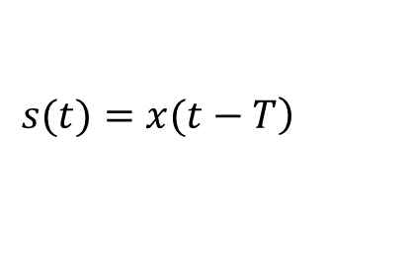
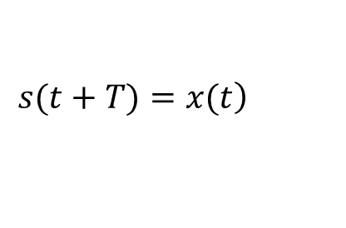
Signal operations
Time shifting
$$\left.s(t+T)=x(t\right)$$
$$\left.s(t)=x(t−T\right)$$

Slide 16
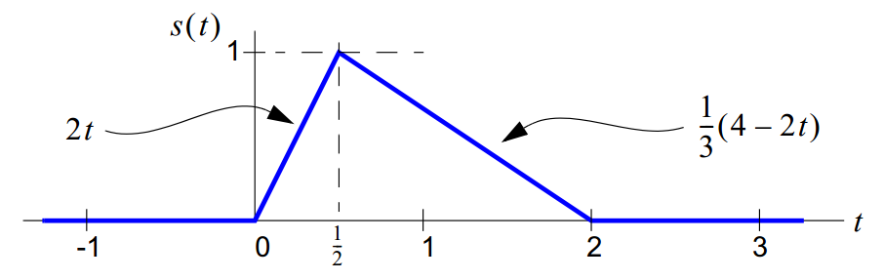
Signal operations
Example 2.1
Consider a triangularly shaped signal having piece wise continuous definition

Slide 17
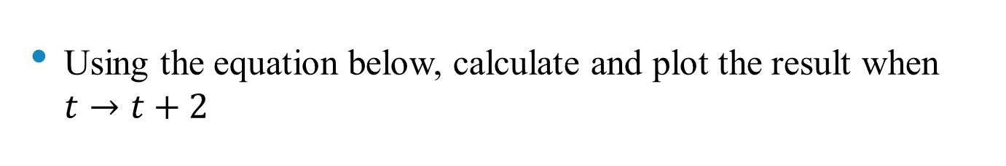
Self check
Using the equation below, calculate and plot the result when $t→t+2$

Slide 18
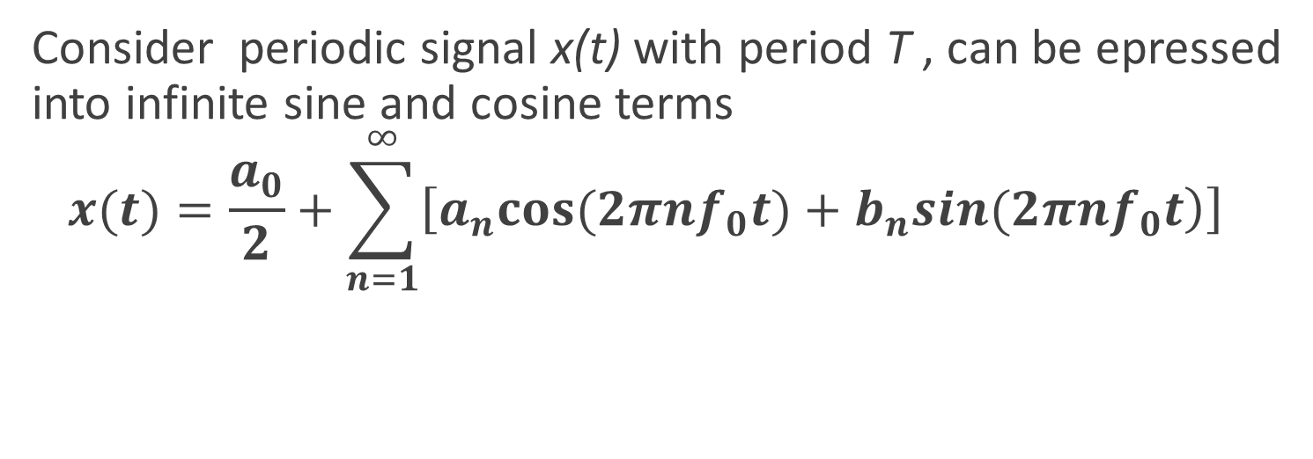
Fourier series
Consider periodic signal x(t) with period T , can be epressed into infinite sine and cosine terms
  $$x(t)=\frac{a_{0}}{2}+\sum_{n=1}^{∞}{\left[\left.a_{n}cos(2πnf_{0}t)+b_{n}sin(2πnf_{0}t\right)\right]}$$
Notes:
Where $f_{0}$ is fundamental freq. given as $f_{0}=\frac{1}{T_{0}}$, a_{n} and b_{n} represent amplitude of cosine and sine components
Fourier series allows signals to be decomposed into an infinite sum of sinusoids that highlights on the frequency components of signals
A periodic signal, x(t), with period T can be decomposed into a weighted sum of complex sinusoids with frequencies that are an integer multiple of the fundamental frequency $f_{0}=\frac{1}{T_{0}}$
Read Fourier properties from handout

Slide 19
Synthesis – basically
T is a period of all the above signals
Even Part
Odd Part
DC Part
Let ω₀=2π/T.

Slide 20
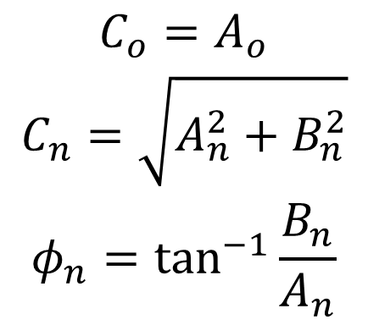
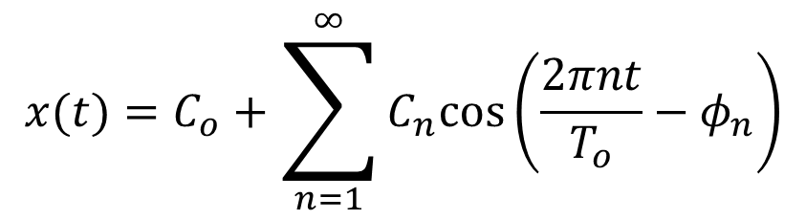
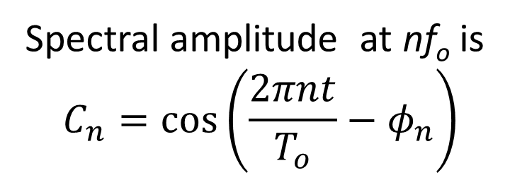
Fourier series
Alternative form
$$x(t)=C_{o}+\sum_{n=1}^{∞}{C_{n}cos\left(\frac{2πnt}{T_{o}}−φ_{n}\right)}$$
Where Co, Cn and $φ_{n}$ are related to Ao, An, and Bn by the equation
$$\begin{matrix}C_{o}=A_{o} \\ C_{n}=\sqrt{A_{n}^{2}+B_{n}^{2}} \\ φ_{n}=\tan^{−1}\frac{B_{n}}{A_{n}}\end{matrix}$$
Spectral amplitude at nf_{o} is
$$C_{n}=cos\left(\frac{2πnt}{T_{o}}−φ_{n}\right)$$
Notes:
Cn is the magnitude,
$φ_{n}$ is the phase
Check handout for spectral diagram

Slide 21
Fourier series – Parseval’s theorem
Every term of the Fourier series of a periodic signal is also power signal as the signal itself.
The Fourier series of periodic signal consists of terms that are mutually orthogonal over one period
  the power of the series is equal to the sum of the powers of its Fourier components. This forms what is called the Parseval’s theorem
The squared magnitude of the Fourier Series coefficients indicates power at corresponding frequencies

Slide 22
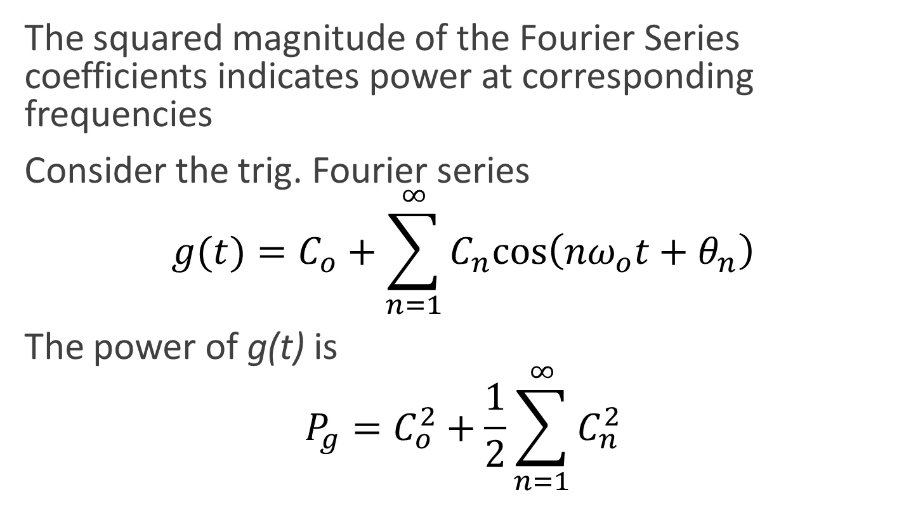
Fourier series – Parseval’s theorem
The squared magnitude of the Fourier Series coefficients indicates power at corresponding frequencies
Consider the trig. Fourier series
$$g(t)=C_{o}+\sum_{n=1}^{∞}{C_{n}cos\left(nω_{o}t+θ_{n}\right)}$$
The power of g(t) is
$$P_{g}=C_{o}^{2}+\frac{1}{2}\sum_{n=1}^{∞}{C_{n}^{2}}$$
Notes:
$$P_{g}=C_{o}^{2}+\frac{1}{2}\sum_{n=1}^{∞}{C_{n}^{2}}$$

Slide 23
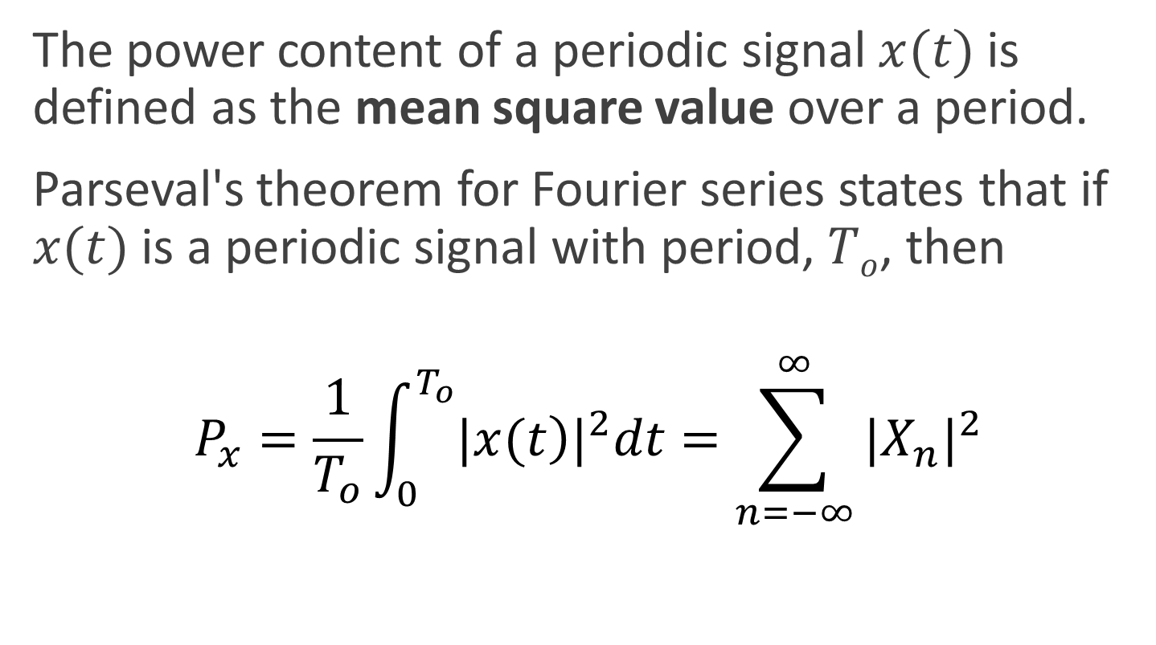
Fourier series – Parseval’s theorem
The power content of a periodic signal $x(t)$is defined as the mean square value over a period.
Parseval's theorem for Fourier series states that if $x(t)$is a periodic signal with period, $To$, then
$$P_{x}=\frac{1}{T_{o}}\int_{0}^{T_{o}}{{|\left.x(t\right)|}^{2}dt}=\sum_{n=−∞}^{∞}{{|X_{n}|}^{2}}$$

Slide 24

Example 2.1 pg 39
Consider the signal
$$x(t)=cos\left(ω_{o}t\right)+\sin^{2}\left(2ω_{o}t\right)$$
Where $ω_{o}={2π}/{T_{o}}$
Find the complex exponential Fourier series

Slide 25
Example (Square Wave)
f(t)
1
-6π
-5π
-4π
-3π
-2π
-π
π
2π
3π
4π
5π

Slide 26

Example 2.2 pg 39
What are fundamental frequency and Fourier series coefficients of the following signal (Hint:
You don’t need to calculate any integral!)
$$\left.s(t)=10sin(20πt)+2cos(40πt+π/3)+0.5sin(80πt+π/4\right)$$

Slide 27
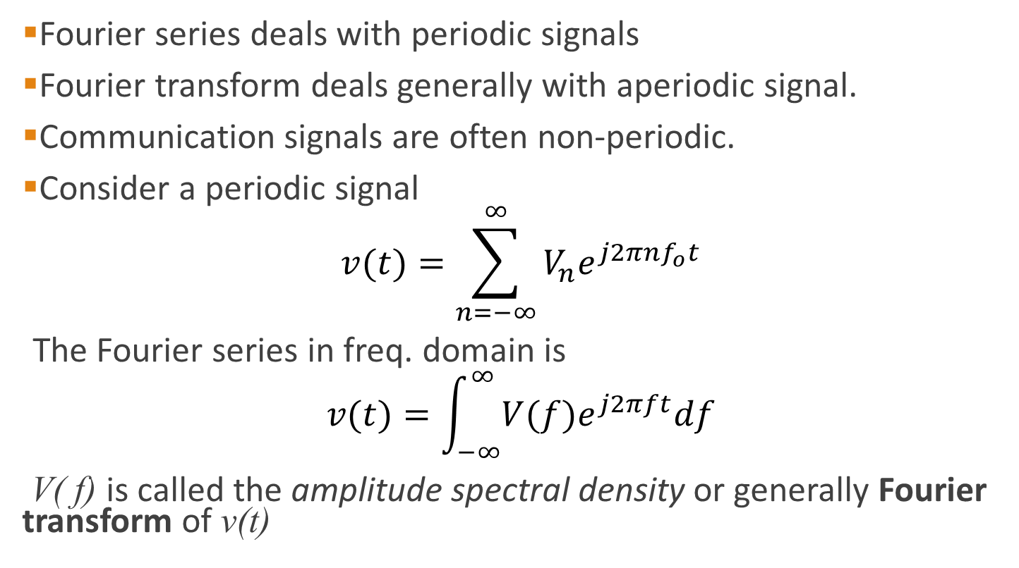
Fourier transform
Fourier series deals with periodic signals
Fourier transform deals generally with aperiodic signal.
Communication signals are often non-periodic.
Consider a periodic signal
$$v(t)=\sum_{n=−∞}^{∞}{V_{n}e^{j2πnf_{o}t}}$$
The Fourier series in freq. domain is
$$v(t)=\int_{−∞}^{∞}{V(f)e^{j2πft}df}$$
V( f) is called the amplitude spectral density or generally Fourier transform of v(t)
Notes:
$$v(t)=\int_{−∞}^{∞}{V(f)e^{j2πft}df}$$

Slide 28
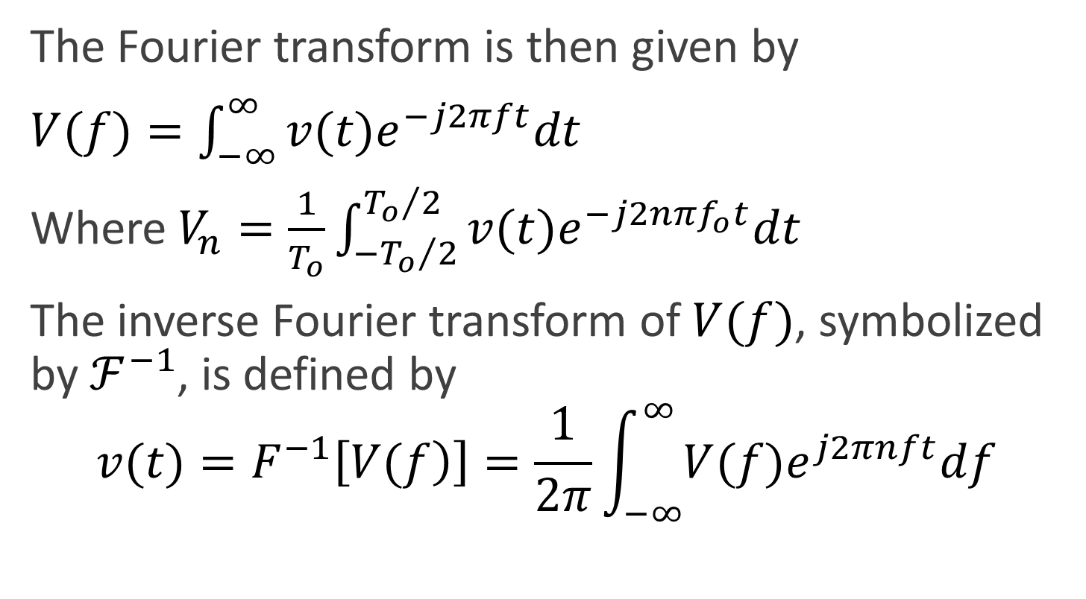
Fourier transform
The Fourier transform is then given by
$V(f)=\int_{−∞}^{∞}{v(t)e^{−j2πft}dt}$
Where $V_{n}=\frac{1}{T_{o}}\int_{−{T_{o}}/2}^{{T_{o}}/2}{v(t)e^{−j2nπf_{o}t}dt}$
The inverse Fourier transform of $V(f)$, symbolized by $ℱ^{−1}$, is defined by
$$v(t)=F^{−1}\left[\left.V(f\right)\right]=\frac{1}{2π}\int_{−∞}^{∞}{V(f)e^{j2πnft}df}$$

Slide 29

Example 2.1 pg 46
If $v(t)=cosω_{o}t$, $V(f)$
Solution on the board

Slide 30
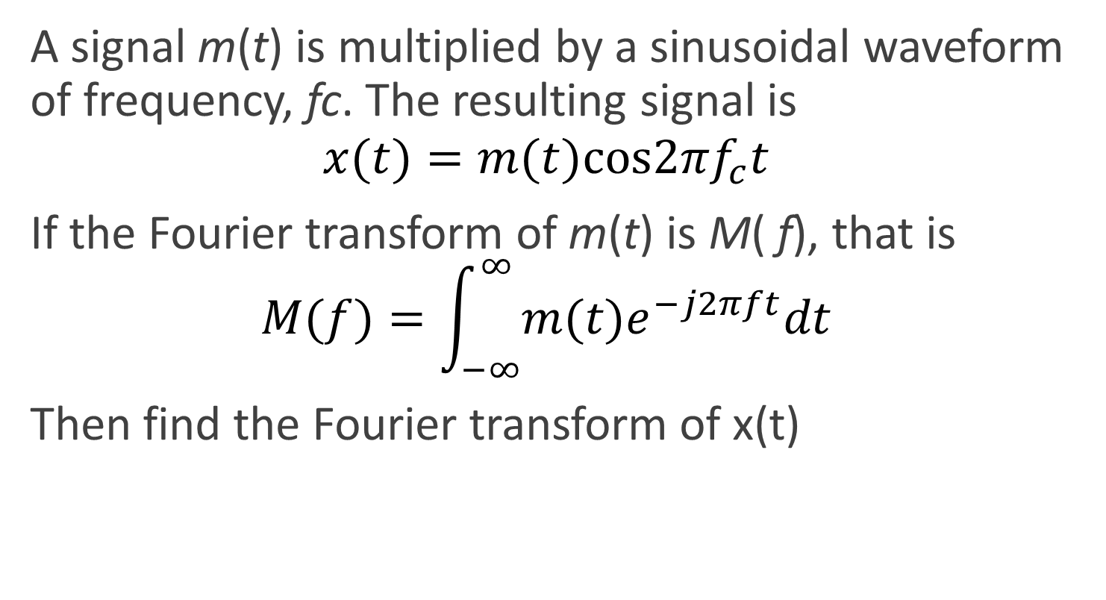
Example 2.2 pg 46
A signal m(t) is multiplied by a sinusoidal waveform of frequency, fc. The resulting signal is
$$x(t)=m(t)cos2πf_{c}t$$
If the Fourier transform of m(t) is M( f), that is
$M(f)=\int_{−∞}^{∞}{m(t)e^{−j2πft}dt}$
Then find the Fourier transform of x(t)
Notes:
$$M(f)=\int_{−∞}^{∞}{m(t)e^{−j2πft}dt}$$

Slide 31
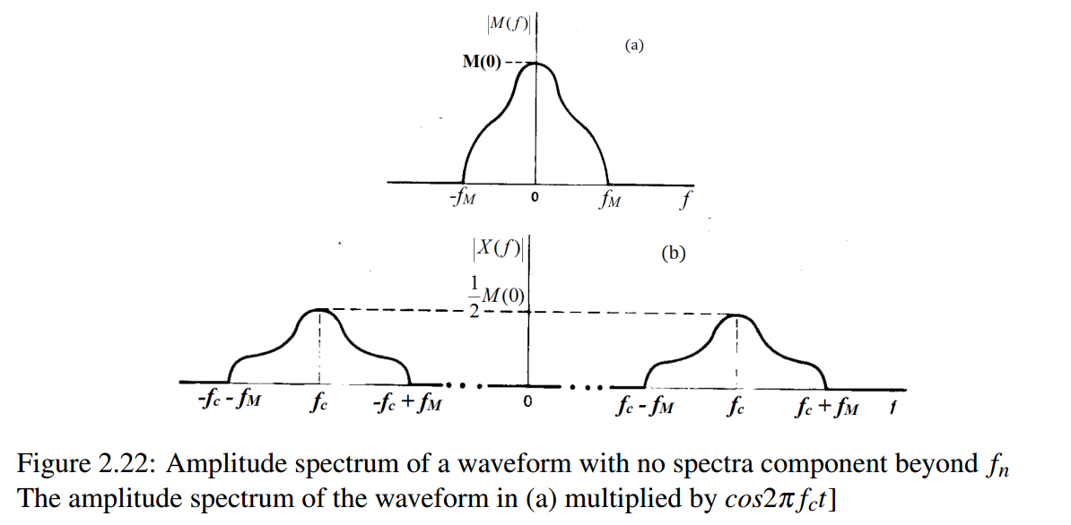
Example 2.2 pg 46
A signal m(t) is multiplied by a sinusoidal waveform of frequency, fc. The resulting signal is
$$x(t)=m(t)cos2πf_{c}t$$
If the Fourier transform of m(t) is M( f), that is
$M(f)=\int_{−∞}^{∞}{m(t)e^{−j2πft}dt}$
Then find the Fourier transform of x(t)
Notes:
$$M(f)=\int_{−∞}^{∞}{m(t)e^{−j2πft}dt}$$

Slide 32
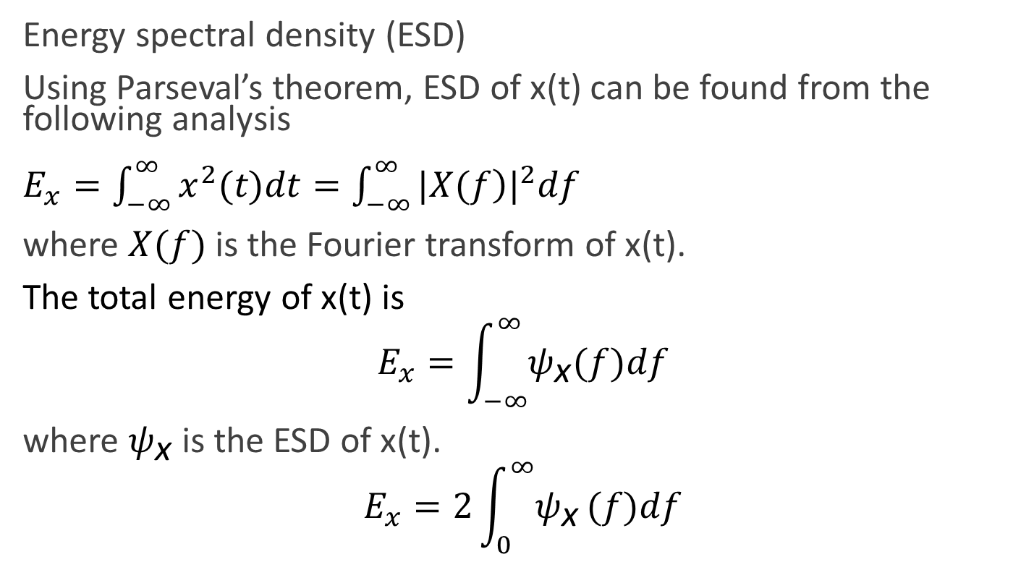

Spectral Densities
Energy spectral density (ESD)
Using Parseval’s theorem, ESD of x(t) can be found from the following analysis
$E_{x}=\int_{−∞}^{∞}{x^{2}(t)dt}=\int_{−∞}^{∞}{{|\left.X(f\right)|}^{2}df}$
where $X(f)$ is the Fourier transform of x(t).
The total energy of x(t) is
$$E_{x}=\int_{−∞}^{∞}{ψ_{\text{x}}(f)df}$$
where $ψ_{\text{x}}$ is the ESD of x(t).
$$E_{x}=2\int_{0}^{∞}{ψ_{\text{x}}}(f)df$$
Making use of symmetry i.e. $|\left.X(f\right)|$ is an even fxn

Slide 33
Spectral Densities
Power Spectral Density (PSD) is the frequency response of a random or periodic signal. It tells us where the average power is distributed as a function of frequency.
The power spectral density (PSD) S_{x}(f) for a signal is a measure of its power distribution as a function of frequency
It is a useful concept which allows us to determine the bandwidth required of a transmission system

Slide 34
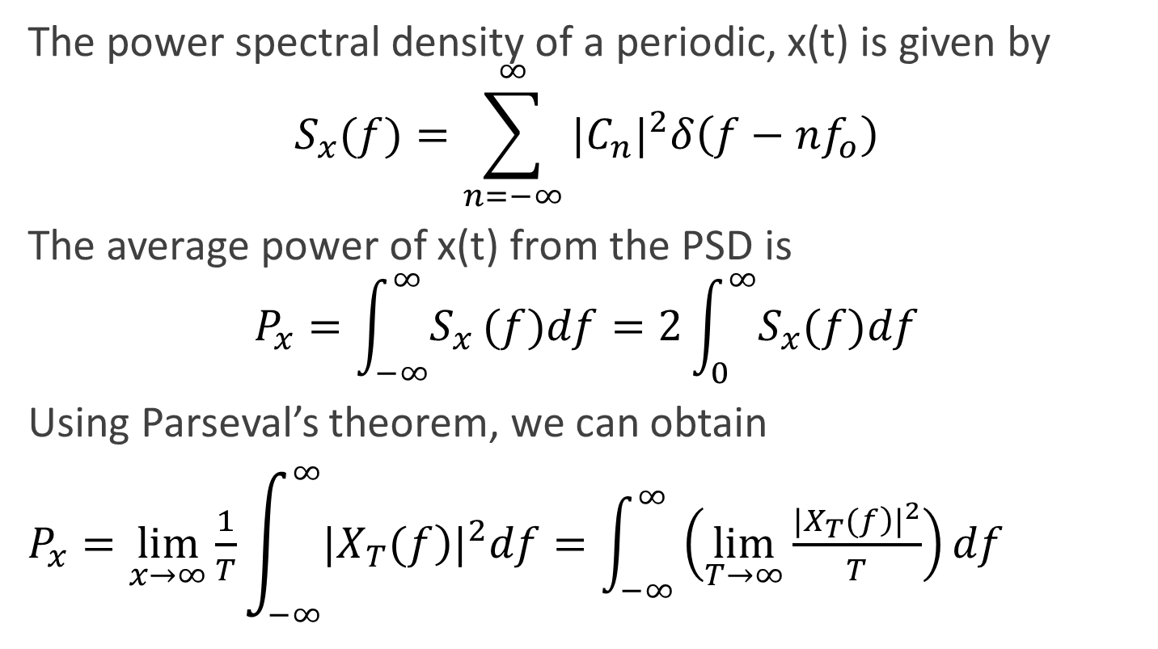
Spectral Densities
The power spectral density of a periodic, x(t) is given by
$$S_{x}(f)=\sum_{n=−∞}^{∞}{{|C_{n}|}^{2}δ\left(f−nf_{o}\right)}$$
The average power of x(t) from the PSD is
$$P_{x}=\int_{−∞}^{∞}{S_{x}}(f)df=2\int_{0}^{∞}{S_{x}(f)df}$$
Using Parseval’s theorem, we can obtain
$P_{x}=\lim_{x→∞}\frac{1}{T}\int_{−∞}^{∞}{{|\left.X_{T}(f\right)|}^{2}df=\int_{−∞}^{∞}{\left(\lim_{T→∞}\frac{{|\left.X_{T}(f\right)|}^{2}}{T}\right)df}}$

Slide 35
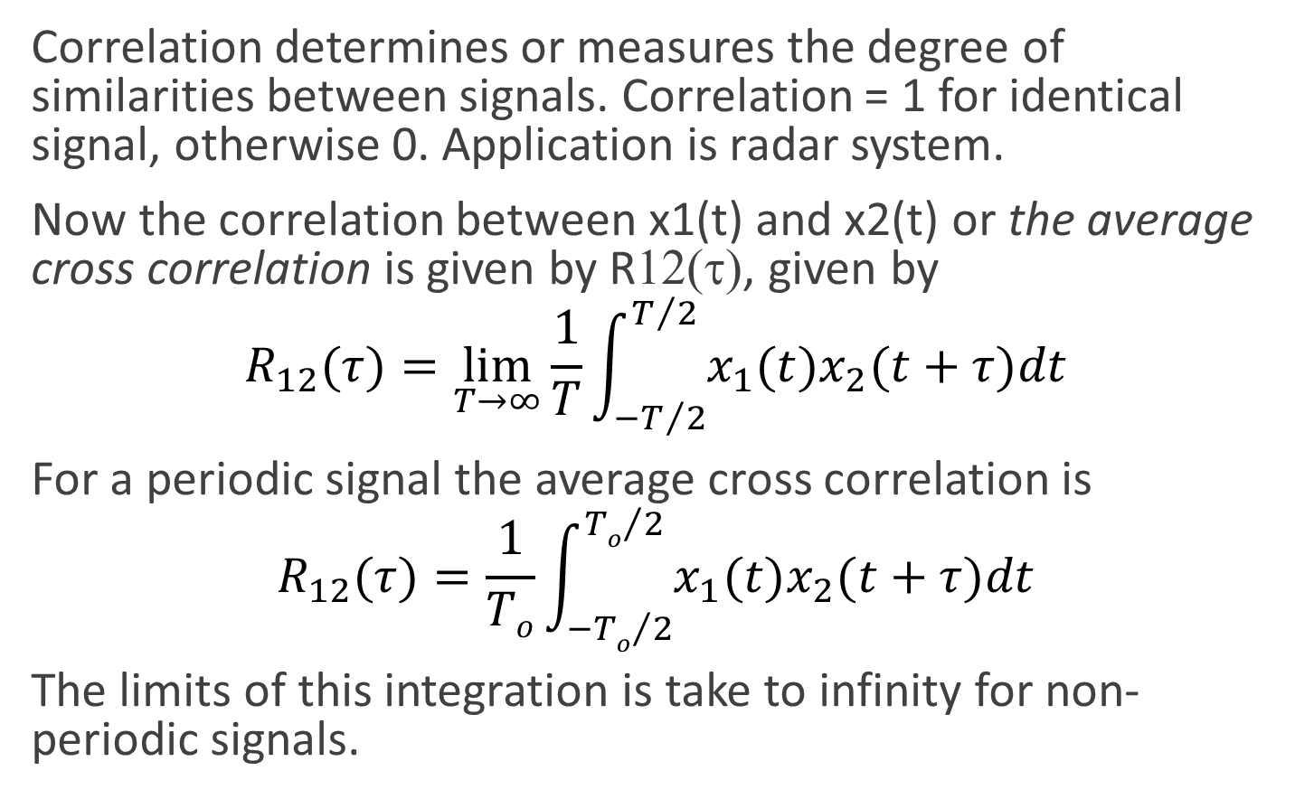
Correlation of signals
Correlation determines or measures the degree of similarities between signals. Correlation = 1 for identical signal, otherwise 0. Application is radar system.
Now the correlation between x1(t) and x2(t) or the average cross correlation is given by R12(τ), given by
$$R_{12}(τ)=\lim_{T→∞}\frac{1}{T}\int_{−T/2}^{T/2}{x_{1}(t)x_{2}(t+τ)dt}$$
For a periodic signal the average cross correlation is
$$R_{12}(τ)=\frac{1}{To}\int_{−{To}/2}^{{To}/2}{x_{1}(t)x_{2}(t+τ)dt}$$
The limits of this integration is take to infinity for non-periodic signals.
Notes:
Check handout for why $τ$ is in the expression

Slide 36
Autocorrelation
Autocorrelation refers to the matching of signal with a delayed version of itself.
Autocorrelation of Energy signal
Autocorrelation of Power signal

Slide 37
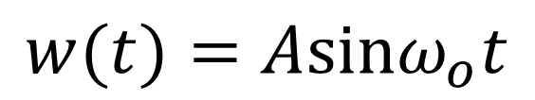
Example 2.1 pg 51
Find the PSD of
$$w(t)=Asinω_{o}t$$

